Slide 1
Models of Respiratory Rhythm Generation in the Pre-Botzinger Complex. I. Bursting Pacemaker Neurons
Presented by: Saumya Puthenveettil

Slide 2
INTRODUCTION
Pre-Botzinger Complex (preBotC) is a cluster of interneurons responsible for respiratory rhythm generation in mammals located in lower brain stem
In vitro medulla slices are taken to demonstrate the pre-BotC oscillatory bursting activity
These isolated slices have allowed the study of rhythmic inspiratory activity
A “hybrid pacemaker-network” model is used to analyze roles of processes in generating rhythm and controlling rhythm.

Slide 3
INTRODUCTION cont’d
This paper models the rhythm and inspiratory bursts.
Little data about the ionic/synaptic processes involved in pre-Botc pacemaker cells

Slide 4
AIM
Study how voltage affects the oscillations of the pre-Botc pacemaker neurons in vitro
Generate a minimal model that generates spike frequencies similar to that of experimental recordings

Slide 5
METHODS AND MATERIALS
Model I and Model II consists of burst initiation via activation of a persistent sodium current.
However in Model I, burst termination occurs by the slow inactivation of sodium, whereas in Model II, burst termination occurs by a slowly activating potassium current.
For this presentation, simulations were performed using MATLAB of Model I which is based on the Hodgkin Huxley equations.

Slide 6
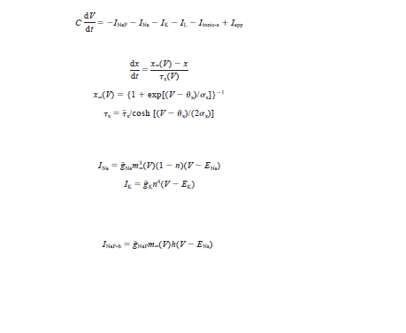
METHODS AND MATERIALS

Slide 7
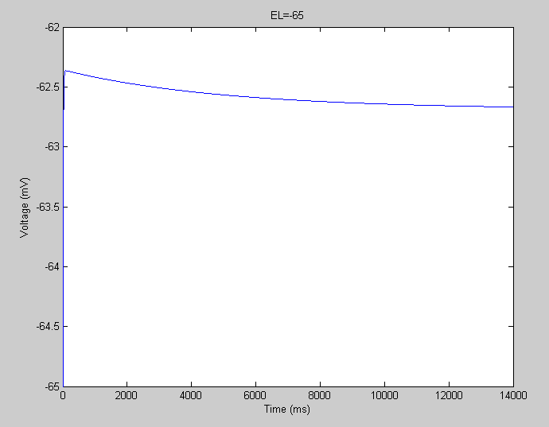
RESULTS

Slide 8
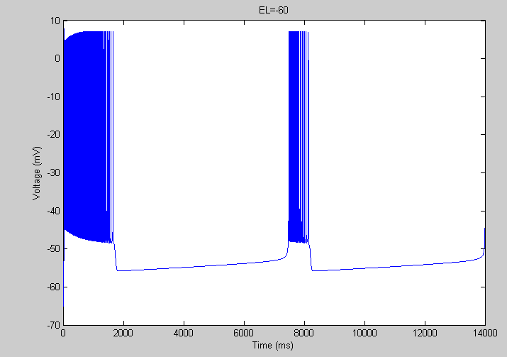
RESULTS

Slide 9
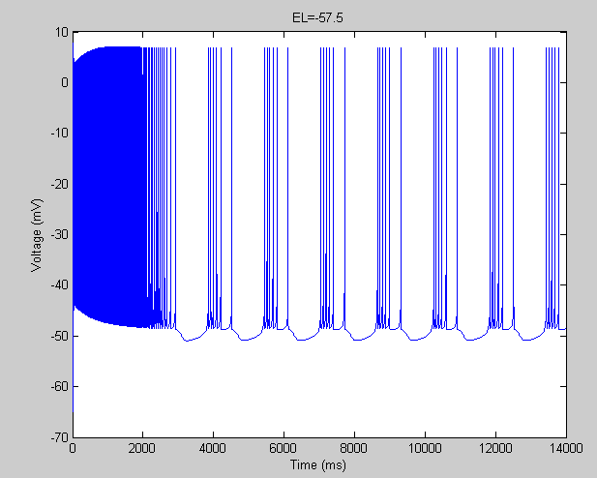
RESULTS

Slide 10
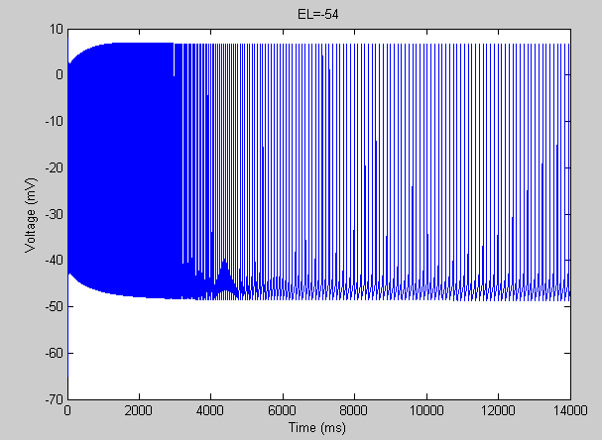
RESULTS

Slide 11
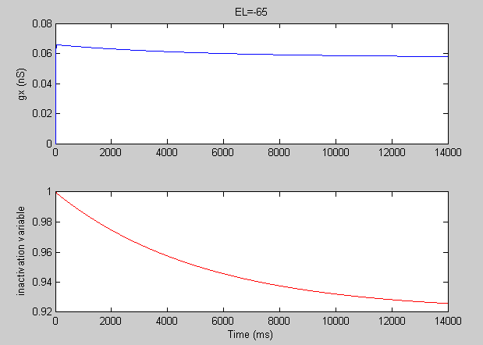
RESULTS

Slide 12
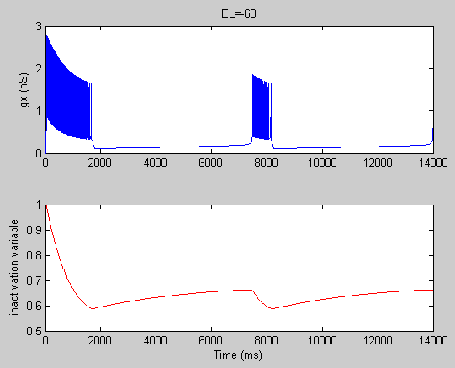
RESULTS

Slide 13
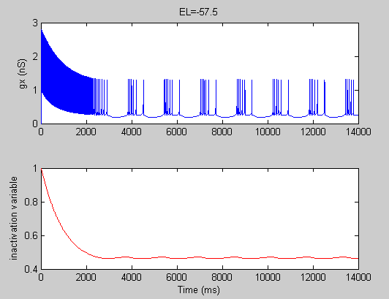
RESULTS

Slide 14
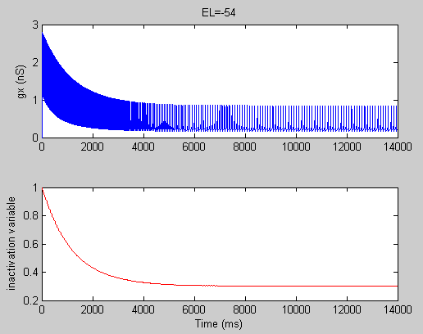
RESULTS

Slide 15
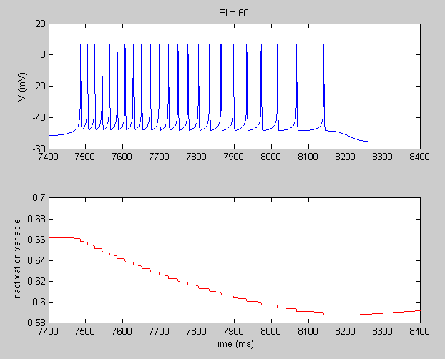
RESULTS

Slide 16
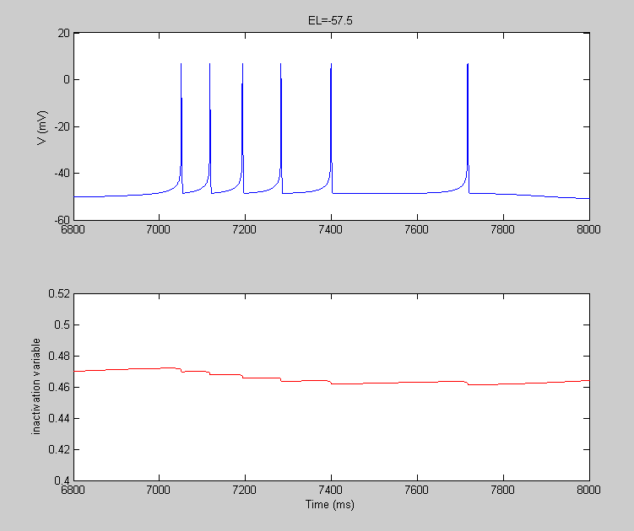
RESULTS

Slide 17
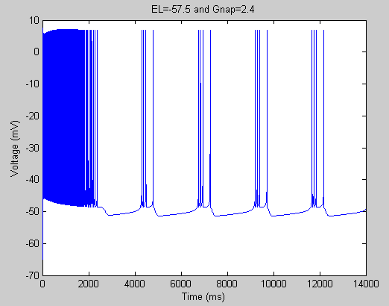
RESULTS

Slide 18
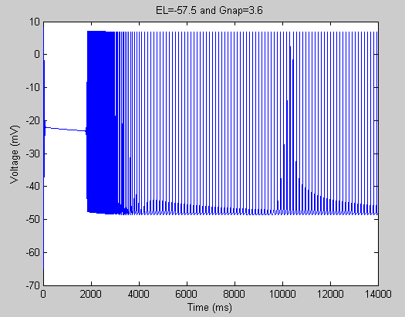
RESULTS

Slide 19
CONCLUSION
Increasing gNap increases burst frequency
Burst frequency increases as membrane potential is depolarized until there is “tonic beating”.
Results are consistent with experimental data

Slide 20
REFERENCES
Butera, R. J., Jr., Rinzel, J., & Smith, J. C. (1999). Models of respiratory rhythm generation in the pre-Botzinger complex. I. Bursting pacemaker neurons. [In Vitro Research Support, U.S. Gov't, P.H.S.]. J Neurophysiol, 82(1), 382-397.
Smith, J. C., Butera, R. J., Koshiya, N., Del Negro, C., Wilson, C. G., & Johnson, S. M. (2000). Respiratory rhythm generation in neonatal and adult mammals: the hybrid pacemaker-network model. [Review]. Respir Physiol, 122(2-3), 131-147.

